Slide 1
Leading Security Standards & Frameworks
A standard or framework is a blueprint or roadmap for achieving Information Security objectives
Examples are ISO27001:2013 (ISMS), PCI DSS, & COBIT

Slide 2
Leading Security Standards & Frameworks
ISO27001:2013 (ISMS)
Specifies the requirements for establishing, implementing, maintaining and continually improving an information security management system
Ten short clauses
Long annex

Slide 3
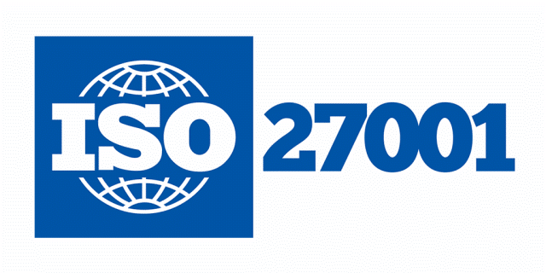
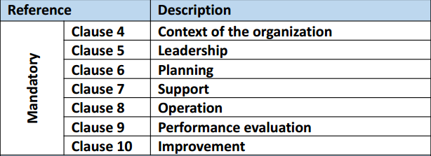
Leading Security Standards & Frameworks
ISO27001:2013 MANDATORY CLAUSES
https://chapters.theiia.org/bermuda/Events/ChapterDocuments/Information%20Security%20Management%20System%20%28ISMS%29%20Overview.pdf

Slide 4
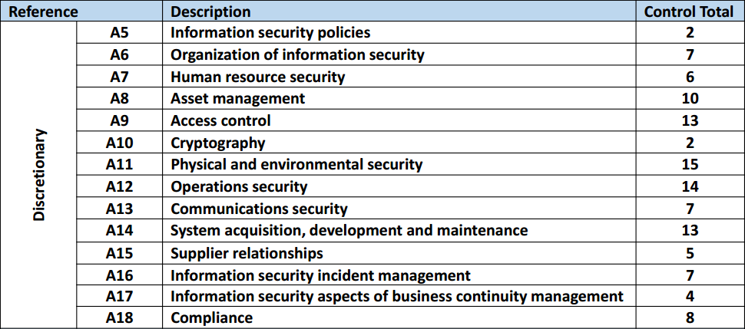
Leading Security Standards & Frameworks
ISO27001:2013 DISCRETIONARY CONTROLS
TOTAL: 113
https://chapters.theiia.org/bermuda/Events/ChapterDocuments/Information%20Security%20Management%20System%20%28ISMS%29%20Overview.pdf

Slide 5

Leading Security Standards & Frameworks
PCI Data Security Standard (DSS):
Designed to ensure that ALL companies that accept, process, store or transmit credit card information maintain a secure environment
Managed by Security Standards Council
https://www.pcicomplianceguide.org/pci-faqs-2/

Slide 6
Leading Security Standards & Frameworks
PCI DSS:
SSC is an independent body that was created by the major payment card brands (Visa, MasterCard, American Express, Discover and JCB
6 Broad goals and 12 requirements
REF: PCI Best Practices For Implementing Security Awareness
https://www.pcisecuritystandards.org/documents/

Slide 7
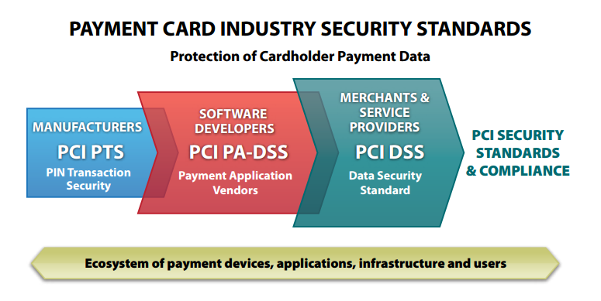
Leading Security Standards & Frameworks
https://www.pcisecuritystandards.org/documents/PCI%20SSC%20Quick%20Reference%20Guide.pdf

Slide 8
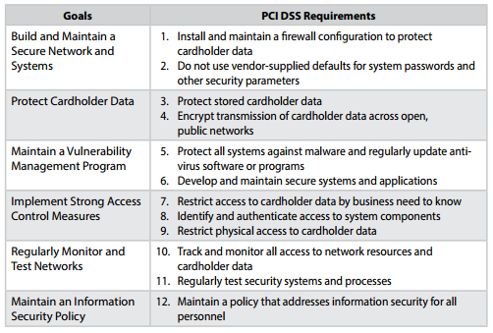
Leading Security Standards & Frameworks
https://www.pcisecuritystandards.org/documents/PCI%20SSC%20Quick%20Reference%20Guide.pdf

Slide 9

Leading Security Standards & Frameworks
COBIT:
ISACA framework for IT Governance
COBIT 5 helps enterprises to create optimal value from IT by maintaining a balance between realising benefits and optimising risk levels and resource use (ISACA)

Slide 10

Leading Security Standards & Frameworks
COBIT 5 brings together five principles that allow the enterprise to build an effective governance and management framework (ISACA)
Based on a holistic set of seven enablers that optimises IT investment and use for the benefit of stakeholders (ISACA)

Slide 11
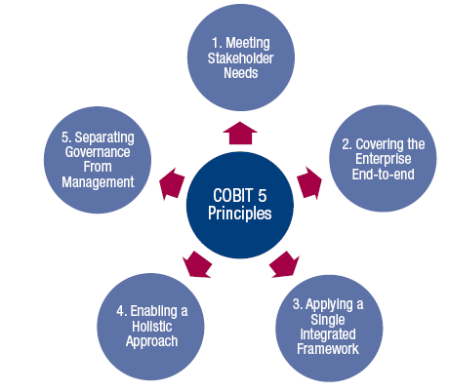
Leading Security Standards & Frameworks

Slide 12
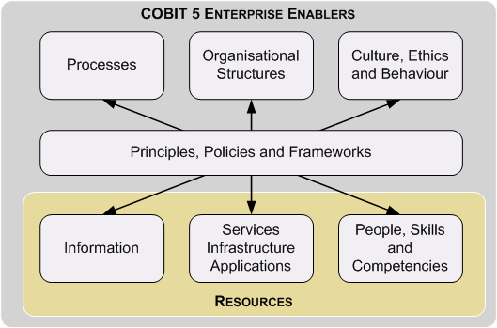
Leading Security Standards & Frameworks

Slide 13
Leading Security Standards & Frameworks
A standard or framework is a blueprint or roadmap for achieving Information Security objectives
Examples are ISO27001:2013 (ISMS), PCI DSS, & COBIT

